Slide 1
Recommended seating positions. The point is that the tRNA should come from “somewhere” which here is the other side of the table. The tRNA is not with the mRNA until the mRNA interacts with the ribosome.
Recorder
tRNA maker
Pile of pop beads
tRNA anticodon strips
Wheel and tRNA passer
Ribosome
mRNA
Protein assembler
mRNA mover

Slide 2
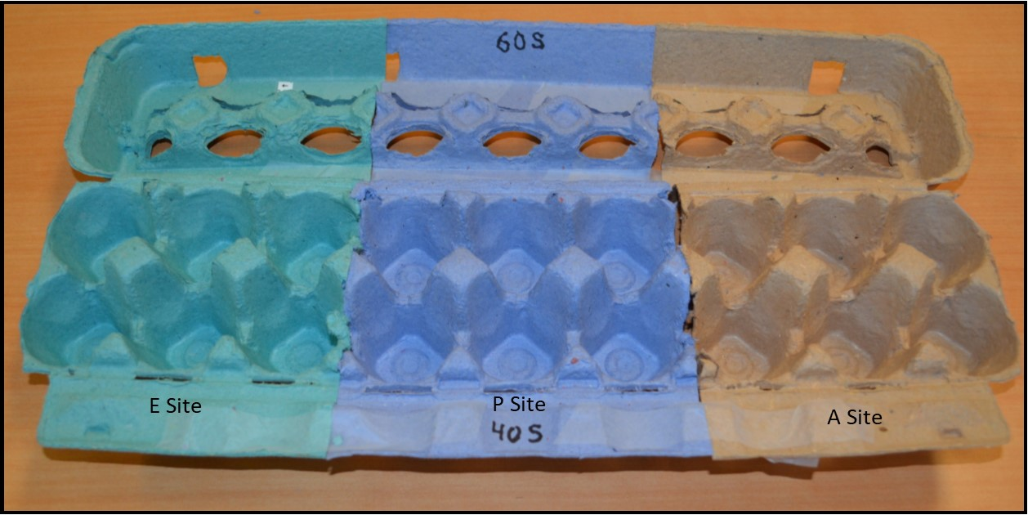
Model of Ribosome

Slide 3
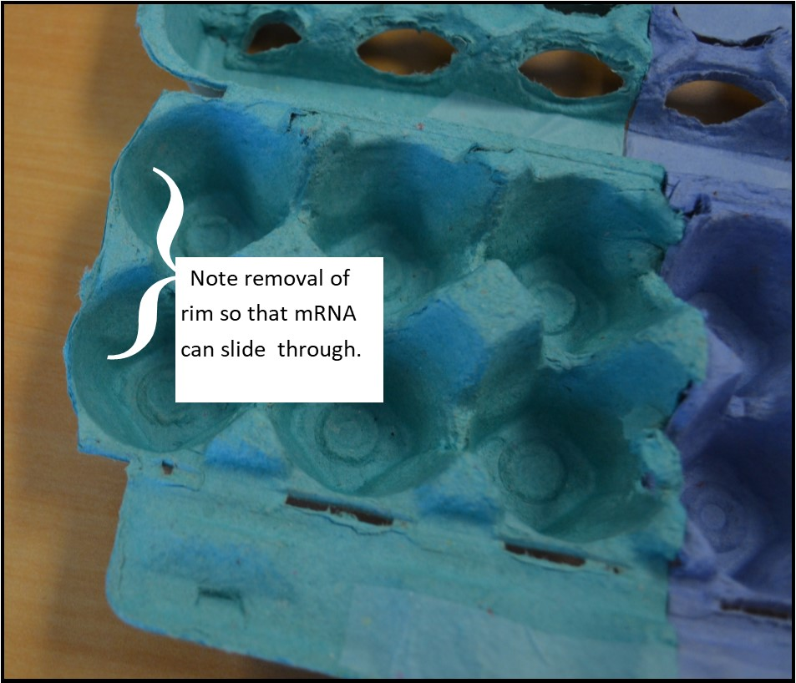

Slide 4
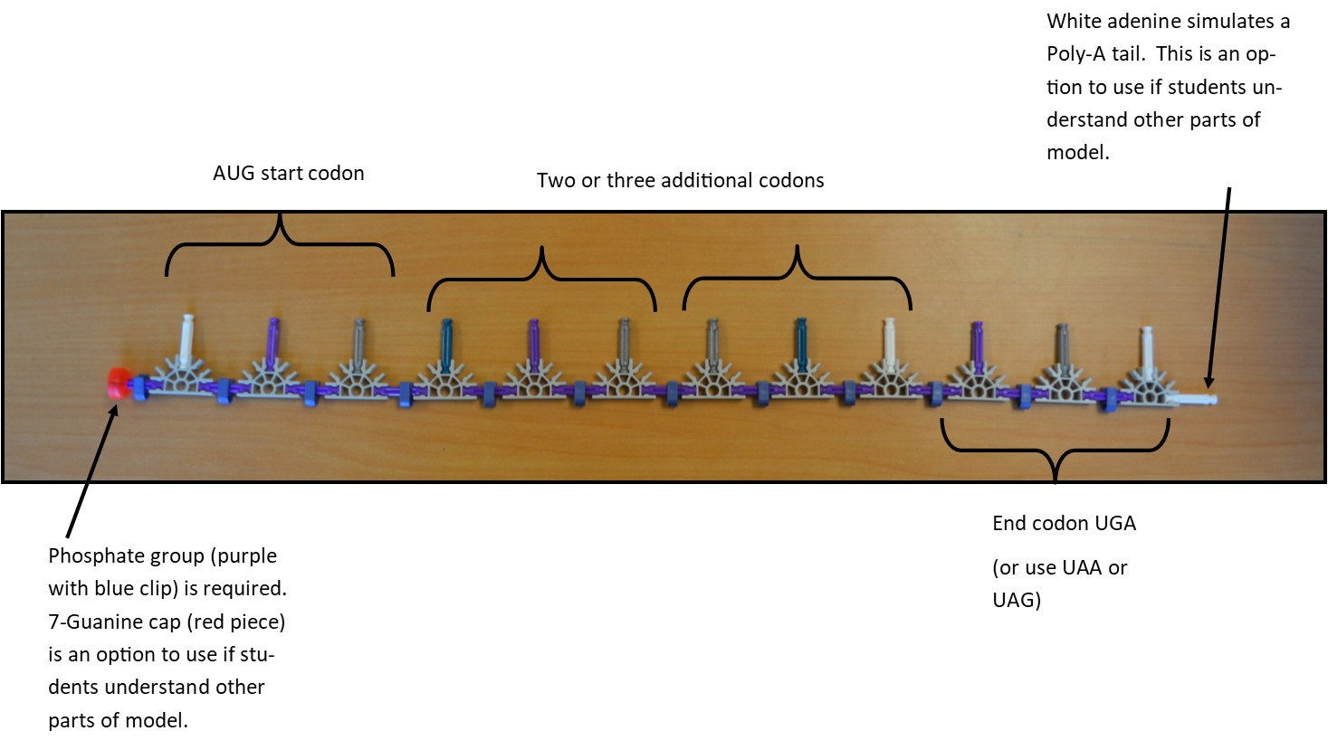
The red cap on the left and the white nitrogenous base on the right are optional. The rest of the model will work without these details. It may be appropriate to include these details for an AP class or any group of students who completely understand the rest of the model. The mRNA shown has 4 codons. Three important points: 1) start with the start codon; stop with a stop codon, 2) the number of nucleotides needs to be a multiple of three, and 3) you have to have enough K’nex pieces so that each group of students gets an mRNA strand, so do not make the strands so long that you run out of pieces for the whole class.

Slide 5
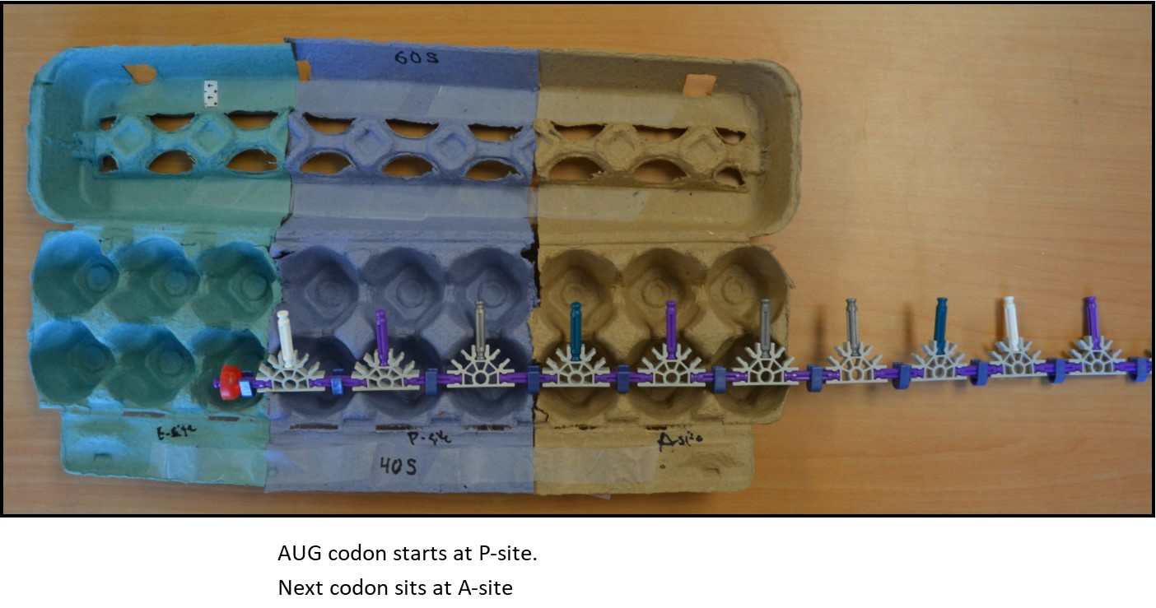
Translation begins

Slide 6
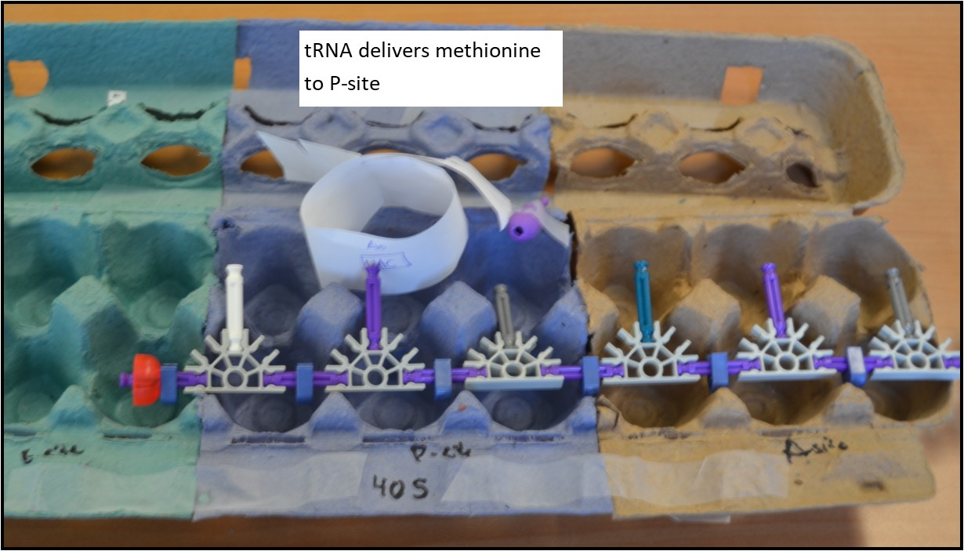
Translation step 2

Slide 7
Translation step 3

Slide 8
Translation step 4

